Slide 1
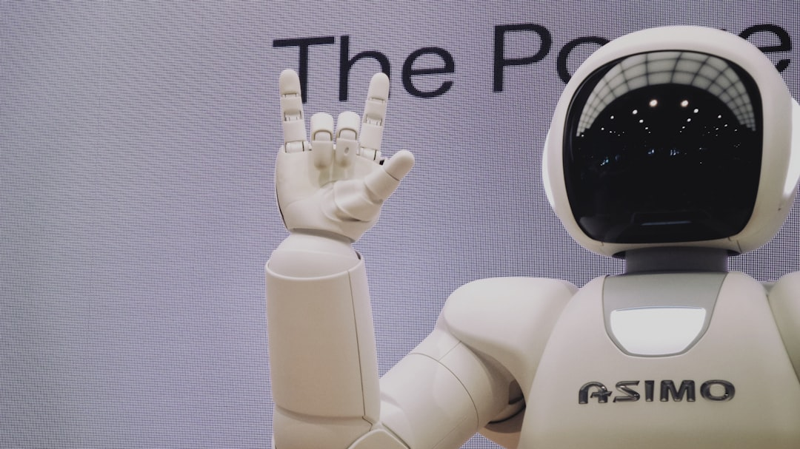
Generative AI IN GAME GURU
By
MAHENDHIRAN S
HARIPRASAD M
DHAMODHARAN S P
NAVEENKUMAR T

Slide 2

Definition & Overview
UNDERSTANDING GENERATIVE AI IN GAME GURU
Generative AI in Game Guru enhances game development by automating content creation. It can create environments, characters, storylines, and other assets by learning patterns from existing game data, streamlining the game design process and unlocking new creative possibilities.

Slide 3
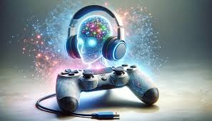
Applications
2. Gameplay Enhancements
Story Creation: Crafting dynamic storylines and quests that adapt to player choices.
NPC Behavior: Enhancing non-playable characters with adaptive AI for more realistic interactions.
Customization: Allowing players or developers to refine and personalize in-game elements easily.
1. Content Creation
Environment Generation: Automatically generating detailed terrains, landscapes, and immersive game worlds.
Character Design: Creating unique characters with realistic features, animations, and behaviors.
Asset Creation: Developing textures, 3D models, and other game assets efficiently.
Procedural Content: Designing endless levels, maps, and scenarios dynamically.

Slide 4
Advantages
1. Development Efficiency
2. Creative Enhancements
3. Player-Centric Customization
Time-Saving: Automates repetitive tasks, reducing manual effort.
Cost-Effective: Lowers development costs by generating assets and content quickly.
Rapid Prototyping: Facilitates quick iterations and testing of game elements.
Innovative Designs: Produces unique assets, characters, and environments.
Dynamic Gameplay: Enables procedurally generated content for diverse player experiences.
Immersive Worlds: Creates high-quality and detailed game elements that elevate realism.
Personalized Experiences: Adapts content based on player preferences or behavior.
Replayability: Offers infinite variations in levels, quests, and scenarios.
Adaptive NPCs: Enhances player interaction with lifelike, evolving non-playable characters.

Slide 5

Challenges
1. Technical Limitations
Data Dependency: Requires large datasets to train AI effectively.
Quality Control: Ensuring AI-generated content meets creative and technical standards.
Performance Impact: Real-time content generation can strain system resources.
Integration Complexity: Seamlessly incorporating AI-generated assets into existing workflows.
2. Creative Constraints
Lack of Originality: AI might replicate patterns from training data, limiting true innovation.
Over-Automation: Excessive reliance on AI can reduce human creativity in game design.
Unpredictability: Generated content may not always align with the intended vision or theme.
Player Experience Risks: Procedural generation can lead to repetitive or unbalanced gameplay.

Slide 6
Key Technologies
This table summarizes key technologies utilized in Game Guru powered by Generative AI, highlighting their functionalities and use cases. These technologies streamline game development and enable the creation of immersive gaming experiences.
TECHNOLOGY | DESCRIPTION | USE CASE
GANs | Generative Adversarial Networks | Creating realistic textures and characters
VAEs | Variational Autoencoders | Generating diverse 3D models and assets
Transformers | Deep learning models for text and behavior generation | Deep learning models for text and behavior generation
Procedural Tools | Algorithms for real-time content creation | Dynamic environments and level design

Slide 7
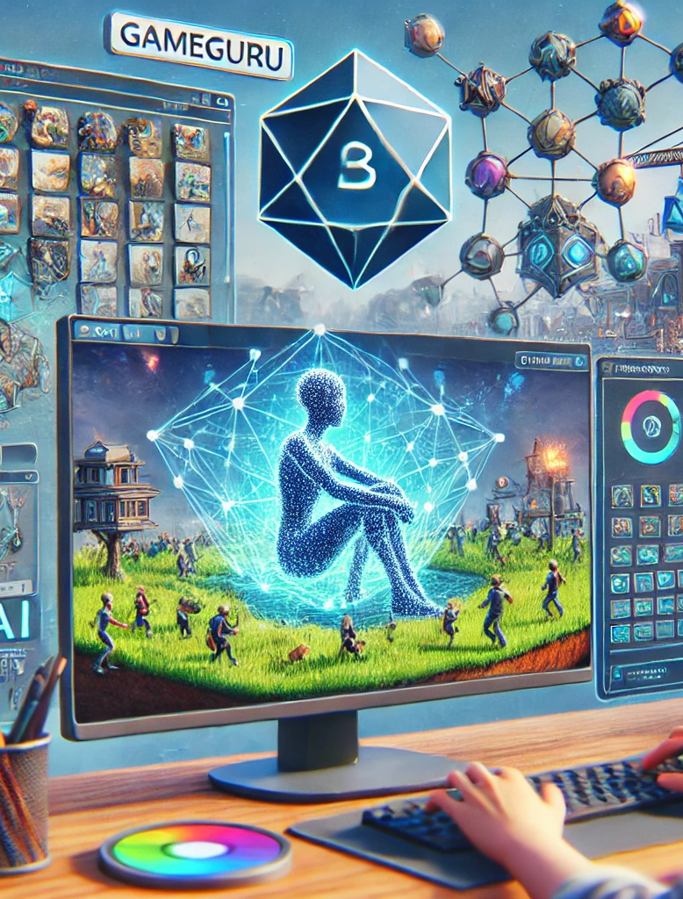
GEN AI GAME GURU
Prompt:
"Imagine using cutting-edge AI tools to transform game creation in GameGuru. Your task is to design a presentation that showcases the integration of Generative AI for automating asset creation, designing dynamic game levels, generating engaging NPC dialogues, and creating immersive soundscapes. Highlight how AI models like GANs and Transformers can assist in speeding up game development, enhancing creativity, and providing unique gaming experiences. Focus on the practical application of these technologies within GameGuru and address potential challenges and future trends in this evolving field."

Slide 8


